Slide 1
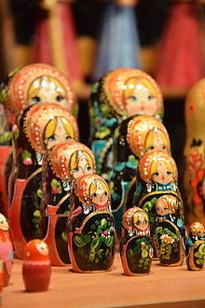
Matryoshka
Simulator
He Yisheng
Huang Zhuofei

Slide 2
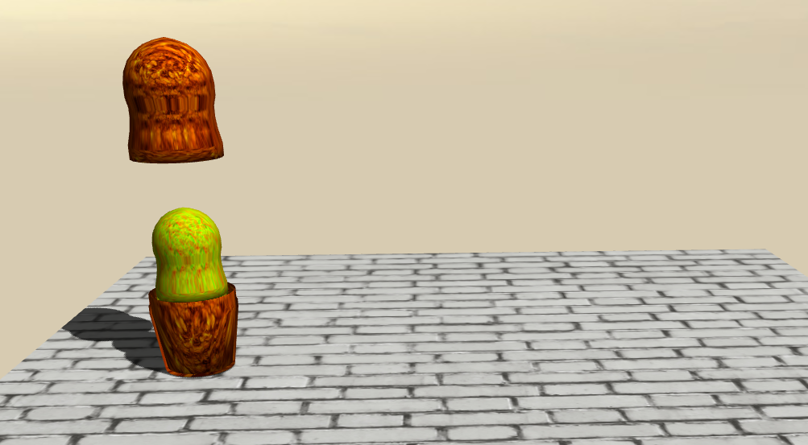
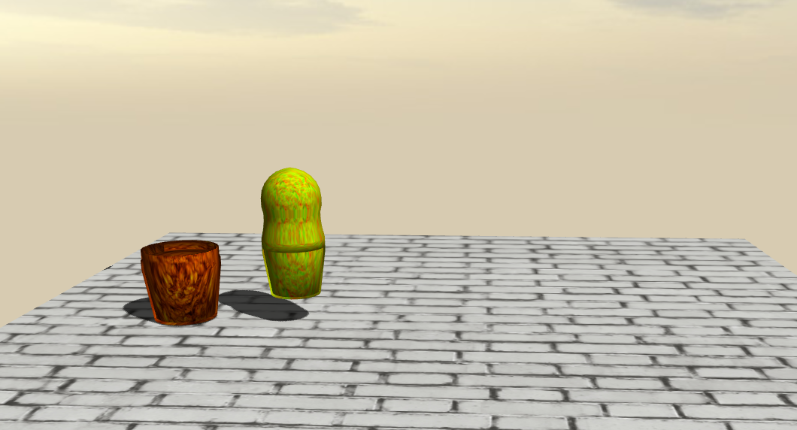
Basic Idea: A Russian Doll Game
A set of wooden dolls of decreasing size placed one inside another.
Opening the “mother" Matryoshka, from which the “son” Matryoshka inside it will jump out.
Five dolls with different materials

Slide 3
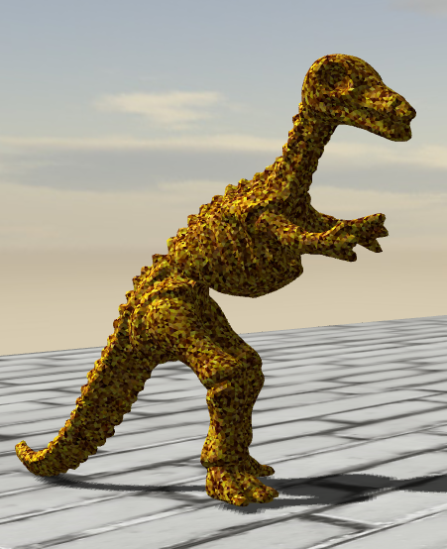
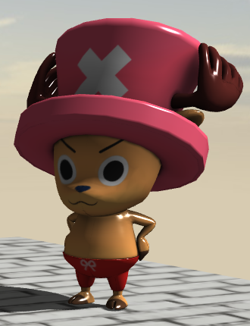
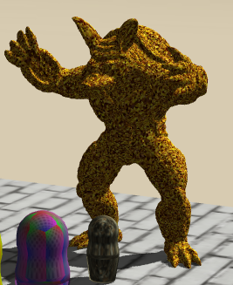
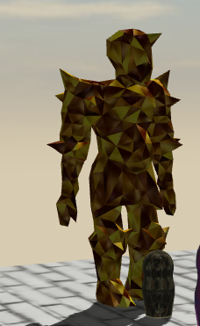
Basic Idea: A Russian Doll Game
We add a random “surprise” (with probability 0.1) at the last jumping out doll with growing size, with an animation of colorful paper belt explosion.
All animations and special effects are implemented by Three.js without any other third-party library.

Slide 4
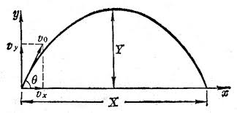
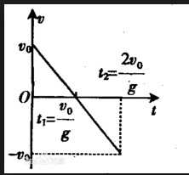
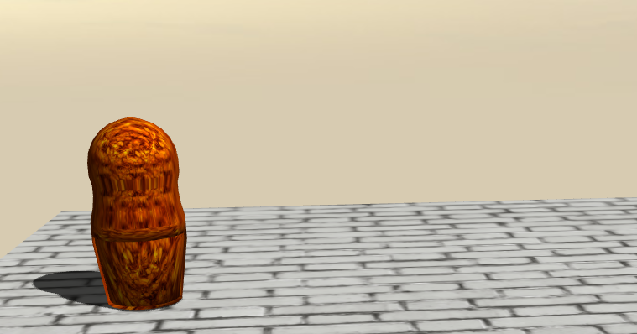
Movement Model
Projectile Motion: when jump out a doll
Vertical projectile motion: opening the top-part of the doll.

Slide 5
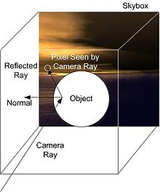
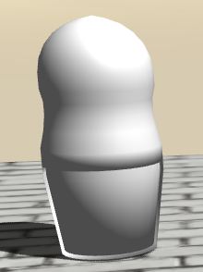
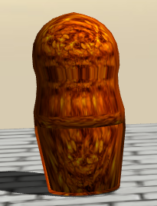
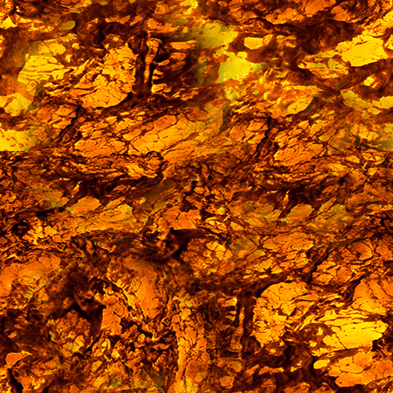
Reflection Mapping
Environment Mapping
Efficient image-based lighting technique for approximating the appearance of a reflective surface by means of a precomputed texture image. The texture is used to store the image of the distant environment surrounding the rendered object.
Our scheme: Object - Sphere Mapping, Background – Cube Mapping

Slide 6
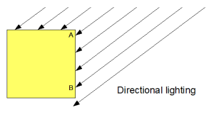
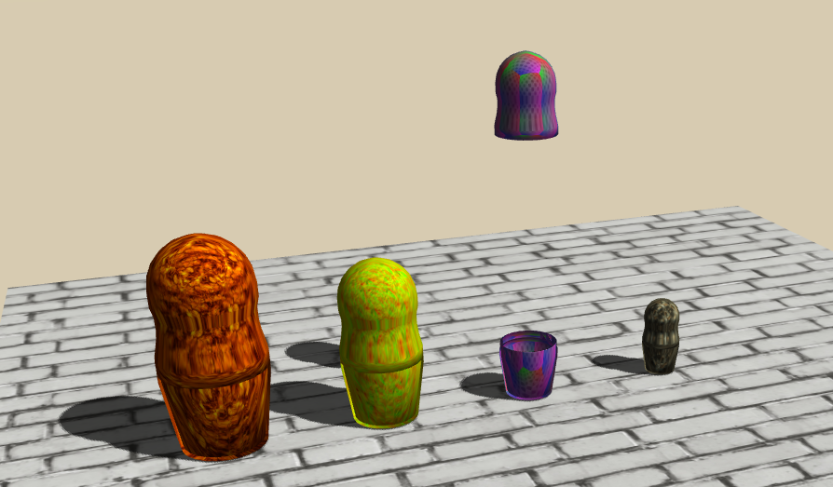
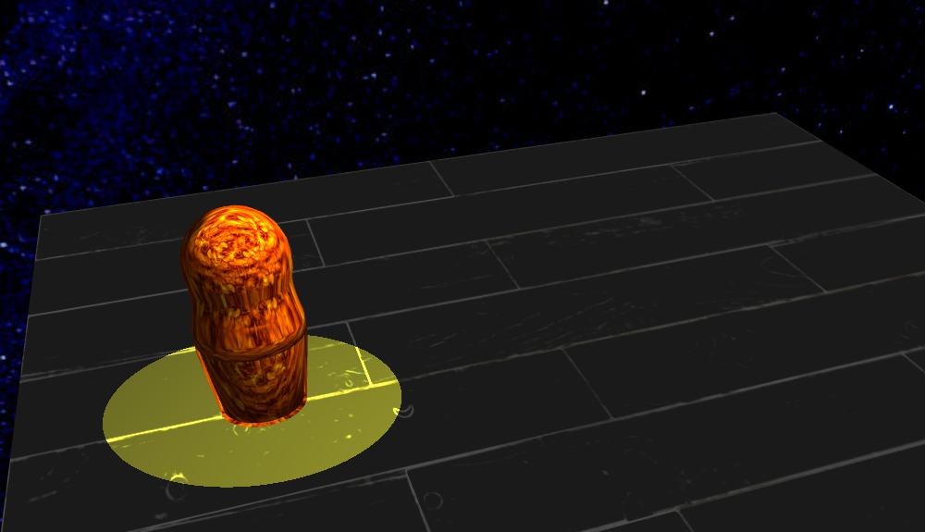
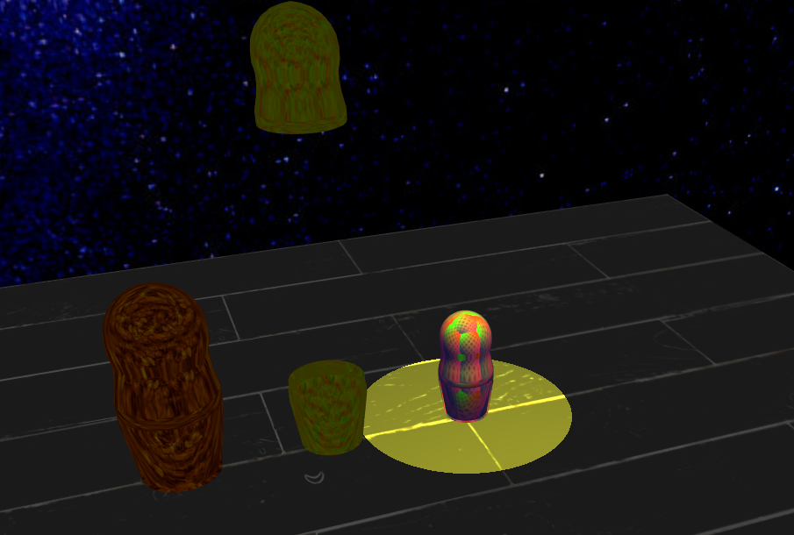
Different Light Shading Mode
Directional Light + Ambient Light
SpotLight + Ambient Light

Slide 7
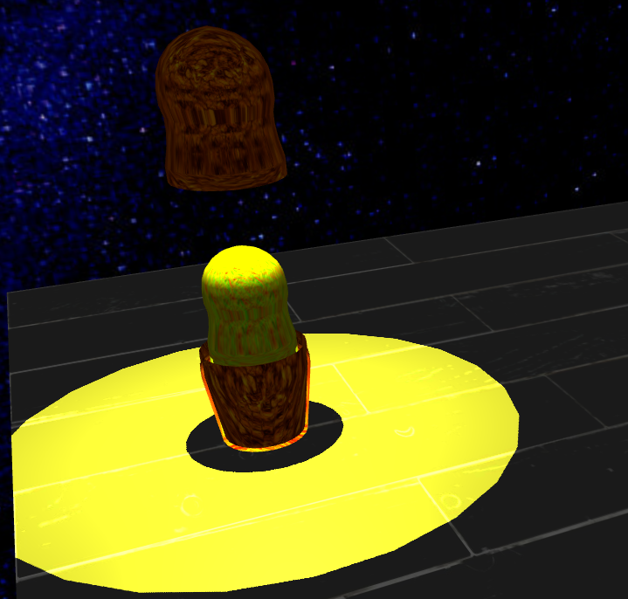
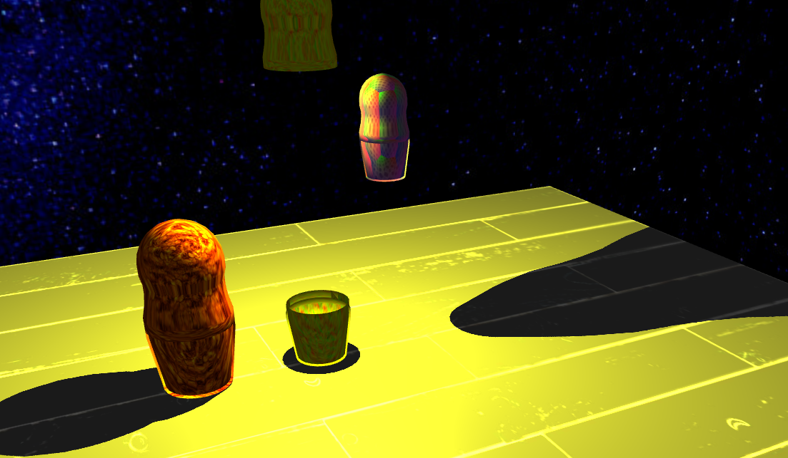
Different Light Shading Mode
Point Light(Inside the dolls at the top, move with the top) + Ambient Light.

Slide 8
Surprising Mode - Explosion
Colorful particles movements to simulate color paper belt explosion.
Seen in demo part

